Slide 1
Introduction to DBMS
Venkat Shiva Reddy
Technical Trainer
Venkatshiva.reddy@gmail.com

Slide 2
What is DBMS?
A database is a structured collection of interrelated data that is stored in a physical location with a specific name.
A database can be a Flat File Database, Relational Database, Distributed Databases etc.
A Database Management System is a system that helps us perform various operations on the data that is stored in a database.

Slide 3
Approaches to Data Management
File-Based Systems Conventionally, before the Database systems evolved, data in software systems was stored in and represented using flat files.
Database Systems Database Systems evolved in the late 1960s to address common issues in applications handling large volumes of data which are also data intensive.
Some of these issues could be traced back to the following disadvantages of File-based systems.

Slide 4
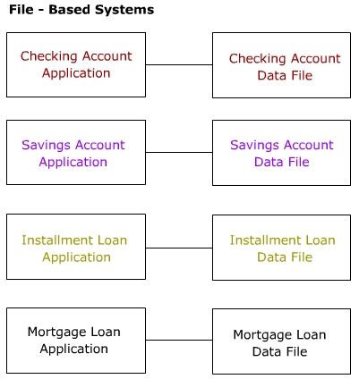
File-Based Systems
As shown in the figure, in a file-based system, different programs in the same application may be interacting with different private data files. There is no system enforcing any standardized control on the organization and structure of these data files.

Slide 5
Drawbacks of File-Based Systems
Data Redundancy and Inconsistency
Since data resides in different private data files, there are chances of redundancy and resulting inconsistency
Unanticipated Queries
In a file-based system, handling sudden/ad-hoc queries can be difficult, since it requires changes in the existing programs.
Data Isolation
Though data used by different programs in the application may be related, they reside in isolated data files.

Slide 6
Drawbacks of File-Based Systems
Concurrent Access Anomalies
In large multi-user systems the same file or record may need to be accessed by multiple users simultaneously. Handling this in a file-based systems is difficult.
Security Problems
In data-intensive applications, security of data is a major concern. Users should be given access only to required data and not the whole database. In a file-based system, this can be handled only by additional programming in each application.
Integrity Problems

Slide 7
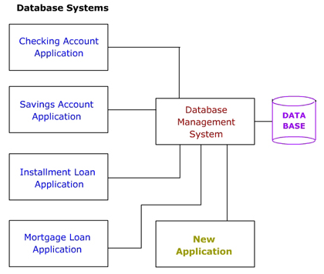
Advantages of DBMS
As shown in the figure, the DBMS is a central system which provides a common interface between the data and the various front-end programs in the application. It also provides a central location for the whole data in the application to reside.

Slide 8
Advantages of DBMS
Minimal Data Redundancy
Since the whole data resides in one central database, the various programs in the application can access data in different data files. Hence data present in one file need not be duplicated in another. This reduces data redundancy.
Data Consistency
Reduced data redundancy leads to better data consistency.
Data Integration
Since related data is stored in one single database, enforcing data integrity is much easier. Moreover, the functions in the DBMS can be used to enforce the integrity rules with minimum programming in the application programs.

Slide 9
Advantages of DBMS
Data Sharing
Related data can be shared across programs since the data is stored in a centralized manner. Even new applications can be developed to operate against the same data.
Enforcement of Standards
Enforcing standards in the organization and structure of data files is required and also easy in a Database System, since it is one single set of programs which is always interacting with the data files.
Application Development Ease
The application programmer need not build the functions for handling issues like concurrent access, security, data integrity, etc. The programmer only needs to implement the application business rules. This brings in application development ease. Adding additional functional modules is also easier than in file-based systems.

Slide 10
Advantages of DBMS
Better Controls
Better controls can be achieved due to the centralized nature of the system.
Data Independence
The architecture of the DBMS can be viewed as a 3-level system comprising the following:
- The internal or the physical level where the data resides.
- The conceptual level which is the level of the DBMS functions
- The external level which is the level of the application programs or the end user.
Reduced Maintenance
Maintenance is less and easy, again, due to the centralized nature of the system.

Slide 11
Functions of a DBMS
Data Definition
The DBMS provides functions to define the structure of the data in the application. These include defining and modifying the record structure, the type and size of fields and the various constraints/conditions to be satisfied by the data in each field.
Data Manipulation
Once the data structure is defined, data needs to be inserted, modified or deleted. The functions which perform these operations are also part of the DBMS. These function can handle planned and unplanned data manipulation needs. Planned queries are those which form part of the application. Unplanned queries are ad-hoc queries which are performed on a need basis.
Data Security & Integrity
The DBMS contains functions which handle the security and integrity of data in the application. These can be easily invoked by the application and hence the application programmer need not code these functions in his/her programs.

Slide 12
Functions of a DBMS
Data Recovery & Concurrency
Recovery of data after a system failure and concurrent access of records by multiple users are also handled by the DBMS.
Data Dictionary Maintenance
Maintaining the Data Dictionary which contains the data definition of the application is also one of the functions of a DBMS.
Performance
Optimizing the performance of the queries is one of the important functions of a DBMS. Hence the DBMS has a set of programs forming the Query Optimizer which evaluates the different implementations of a query and chooses the best among them.
Thus the DBMS provides an environment that is both convenient and efficient to use when there is a large volume of data and many transactions to be processed.

Slide 13
What Is a Relational Database Management System ?
Database Management System = DBMS
Relational DBMS = RDBMS
RDBMS - A database management system (DBMS) with the ability to access data organized in tabular files that can be related to each other by a common field.
An RDBMS has the capability to recombine the data items from different files, providing powerful tools for data usage.
A big software program written by someone else that accesses and updates those files for you

Slide 14
Where are RDBMS used ?
Backend for traditional “database” applications
Backend for large Websites
Backend for Web services

Slide 15
Example of a Traditional Database Application
Suppose we are building a system
to store the information about:
students
courses
professors
who takes what, who teaches what

Slide 16
Can we do it without a DBMS ?
Sure we can! Start by storing the data in files:
students.txt courses.txt professors.txt
Now write C or Java programs to implement specific tasks

Slide 17
Doing it without a DBMS...
Enroll “Mary Johnson” in “CSE444”:
Write a C program to do the following:
Read ‘students.txt’
Read ‘courses.txt’
Find&update the record “Mary Johnson”
Find&update the record “CSE444”
Write “students.txt”
Write “courses.txt”

Slide 18
Problems without an DBMS...
System crashes:
What is the problem ?
Large data sets (say 50GB)
What is the problem ?
Simultaneous access by many users
Need locks: we know them from OS, but now data on disk; and is there any fun to re-implement them ?
Read ‘students.txt’
Read ‘courses.txt’
Find&update the record “Mary Johnson”
Find&update the record “CSE444”
Write “students.txt”
Write “courses.txt”
CRASH !

Slide 19
Enters a DMBS
“Two tier database system”
connection
(ODBC, JDBC)
Database server (someone else’s C program)
Data files
Applications

Slide 20
Functionality of a DBMS
The programmer sees SQL, which has two components:
Data Definition Language - DDL
Data Manipulation Language - DML
query language
Behind the scenes the DBMS has:
Query optimizer
Query engine
Storage management
Transaction Management (concurrency, recovery)

Slide 21
How the Programmer Sees the DBMS
Start with DDL to create tables:
Continue with DML to populate tables:
CREATE TABLE Students (
Name CHAR(30)
SSN CHAR(9) PRIMARY KEY NOT NULL,
Category CHAR(20)
) . . .
INSERT INTO Students
VALUES(‘Charles’, ‘123456789’, ‘undergraduate’)
. . . .

Slide 22
How the Programmer Sees the DBMS
Tables:
Still implemented as files, but behind the scenes can be quite complex
Students:
Takes:
Courses:
“data independence” = separate logical view from physical implementation

Slide 23
Transactions
Enroll “Mary Johnson” in “CSE444”:
BEGIN TRANSACTION;
INSERT INTO Takes
SELECT Students.SSN, Courses.CID
FROM Students, Courses
WHERE Students.name = ‘Mary Johnson’ and
Courses.name = ‘CSE444’
-- More updates here....
IF everything-went-OK THEN COMMIT;
ELSE ROLLBACK
If system crashes, the transaction is still either committed or aborted

Slide 24
Transactions
A transaction = sequence of statements that either all succeed, or all fail
Transactions have the ACID properties:
A = atomicity
C = consistency
I = independence
D = durability

Slide 25
Queries
Find all courses that “Mary” takes
What happens behind the scene ?
Query processor figures out how to answer the query efficiently.
SELECT C.name FROM Students S, Takes T, Courses C WHERE S.name=“Mary” and S.ssn = T.ssn and T.cid = C.cid

Slide 26
Queries, behind the scene
Declarative SQL query
Imperative query execution plan:
sname
SELECT C.name
FROM Students S, Takes T, Courses C
WHERE S.name=“Mary” and
S.ssn = T.ssn and T.cid = C.cid
cid=cid
sid=sid
name=“Mary”
Students
Takes
Courses
The optimizer chooses the best execution plan for a query

Slide 27
Database Systems
The big commercial database vendors:
Oracle
IBM (with DB2) bought Informix recently
Microsoft (SQL Server)
Sybase
Some free database systems (Unix) :
Postgres
MySQL
Predator

Slide 28
New Trends in Databases
Object-relational databases
XML XML XML !
Relational databases with XML support
Middleware between XML and relational databases
Native XML database systems

